Slide 1
UIT2502 – Data Analytics & Visualization
Inferential Statistics

Slide 2
Descriptive vs Inferential Statistics
Descriptive | Inferential
Describe a data set | Make inferences based on a data set
Description is for the complete data | Can only acquire data from samples, because it is too difficult or expensive to collect data from the whole population
Summarizes/reports characteristics of sample/ population data using distribution, central tendency and variability | Uses sample to make reasonable guesses about the larger population
 | making estimates about populations tests hypotheses to draw conclusions about populations

Slide 3
Alert – It’s all about the Sample
With inferential statistics, it’s important to use random and unbiased sampling methods.
If the sample is not representative of population, then you can’t make valid statistical inferences or generalize.
It estimates population parameters (population mean) from sample statistics (sample mean)

Slide 4
Population vs Sample
Population | Sample
Advertisements for IT jobs | The top 50 search results for advertisements for IT jobs in 2023
Songs from Vijay Super Singer | Winning songs from Vijay Super Singer Senior batch
Undergraduate students from TN | 300 undergraduate students from AU in 2023
All countries of the world | Top 5 countries based on highest GDPA and literacy rate

Slide 5
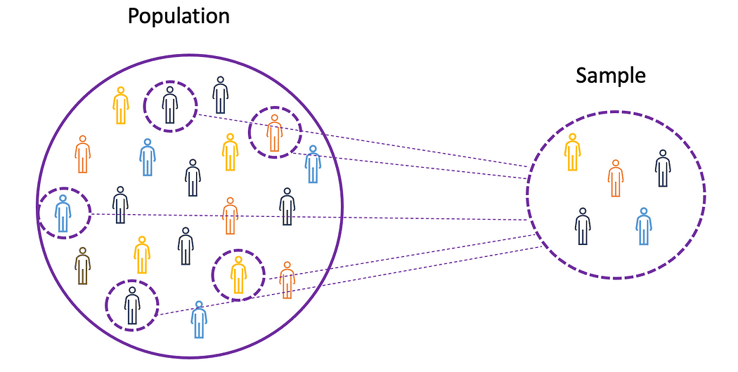
Sampling Error
Sampling error is the difference between a parameter and a corresponding statistic.
Since in most cases you don’t know the real population parameter, you can use inferential statistics to estimate these parameters in a way that takes sampling error into account.

Slide 6
Sampling
In a statistical study, sampling methods refer to how we select members from the population to be in the study.
If a sample isn't randomly selected, it will probably be biased in some way and the data may not be representative of the population.
Good Ways to Sample | Bad Ways to Sample
Simple random sample | Convenience sample
Stratified random sample | Voluntary response sample
Cluster random sample
Systematic random sample

Slide 7
Simple Random Sample
Every member and set of members has an equal chance of being included in the sample.
Example—A teachers puts students' names in a hat and chooses without looking to get a sample of students.
Why it's good: Random samples are usually fairly representative since they don't favor certain members.

Slide 8
Stratified random sample
The population is first split into groups. The overall sample consists of some members from every group. The members from each group are chosen randomly.
Example—A student council surveys 100 students by getting random samples of 25 freshmen, 25 sophomores, 25 juniors, and 25 seniors.
Why it's good: A stratified sample guarantees that members from each group will be represented in the sample, so this sampling method is good when we want some members from every group.

Slide 9
Cluster random sample
The population is first split into groups. The overall sample consists of every member from some of the groups. The groups are selected at random.
Example—An airline company wants to survey its customers one day, so they randomly select 5 flights that day and survey every passenger on those flights.
Why it's good: A cluster sample gets every member from some of the groups, so it's good when each group reflects the population as a whole.

Slide 10
Systematic random sample
Members of the population are put in some order. A starting point is selected at random, and every nth member is selected to be in the sample.
Example—A principal takes an alphabetized list of student names and picks a random starting point. Every 20th student is selected to take a survey.

Slide 11
Convenience sample
The researcher chooses a sample that is readily available in some non-random way.
Example—A researcher polls people as they walk by on the street.
Why it's probably biased: The location and time of day and other factors may produce a biased sample of people.

Slide 12
Voluntary response sample
The researcher puts out a request for members of a population to join the sample, and people decide whether or not to be in the sample.
Example—A TV show host asks his viewers to visit his website and respond to an online poll.
Why it's probably biased: People who take the time to respond tend to have similarly strong opinions compared to the rest of the population.

Slide 13
Let’s understand
A restaurant leaves comment cards on all of its tables and encourages customers to participate in a brief survey to learn about their overall experience.
What type of sampling is this and Why?

Slide 14
Let’s understand
While students are lined up for school pictures, a teacher passes out a survey to every 10th student.
What type of sampling is this and Why?

Slide 15
Let’s understand
Each student at a school has a student identification number. Counselors have a computer generate 50 random identification numbers and those students are asked to take a survey.
What type of sampling is this and Why?

Slide 16
Let’s understand
A quality control worker at a factory selects the first 10 items she sees as her sample for the day.
What type of sampling is this and Why?

Slide 17
Let’s understand
A principal orders t-shirts and wants to check some of them to make sure they were printed properly. She randomly selects 2 of the 10 boxes of shirts and checks every shirt in those 2 boxes.
What type of sampling is this and Why?

Slide 18
Let’s understand
A school chooses 3 randomly selected athletes from each of its sports teams to participate in a survey about athletics at the school.
What type of sampling is this and Why?

Slide 19
Books
TEXTBOOKS:
David Cielen, Arno D. B. Meysman, and Mohamed Ali, “Introducing Data Science”, Manning Publications, 2016. (first two chapters for Unit I).
Robert S. Witte and John S. Witte, “Statistics”, Eleventh Edition, Wiley Publications, 2017.
Jake VanderPlas, “Python Data Science Handbook”, O’Reilly, 2016.
REFERENCES:
Allen B. Downey, “Think Stats: Exploratory Data Analysis in Python”, Green Tea Press, 2014.

